Slide 1
Siamese Network
Manoj Maharana

Slide 2
Learning Pairwise Similarity Scores
Reference:
Bromley et al. Signature verification using a Siamese time delay neural network. In NIPS. 1994.
Koch, Zemel, & Salakhutdinov. Siamese neural networks for one-shot image recognition. In ICML, 2015.

Slide 3
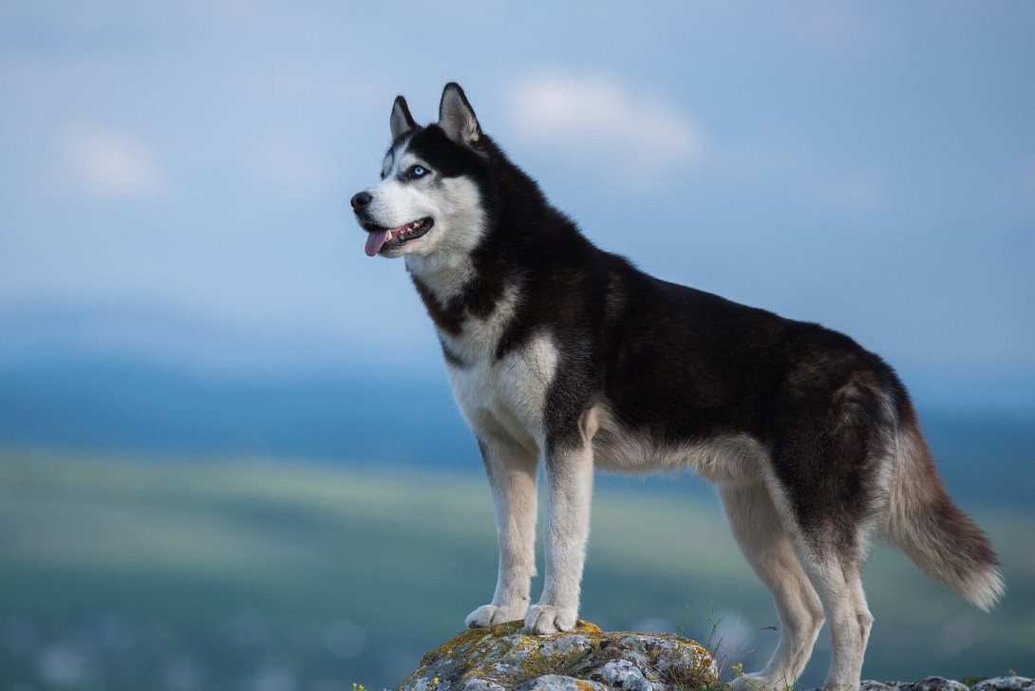
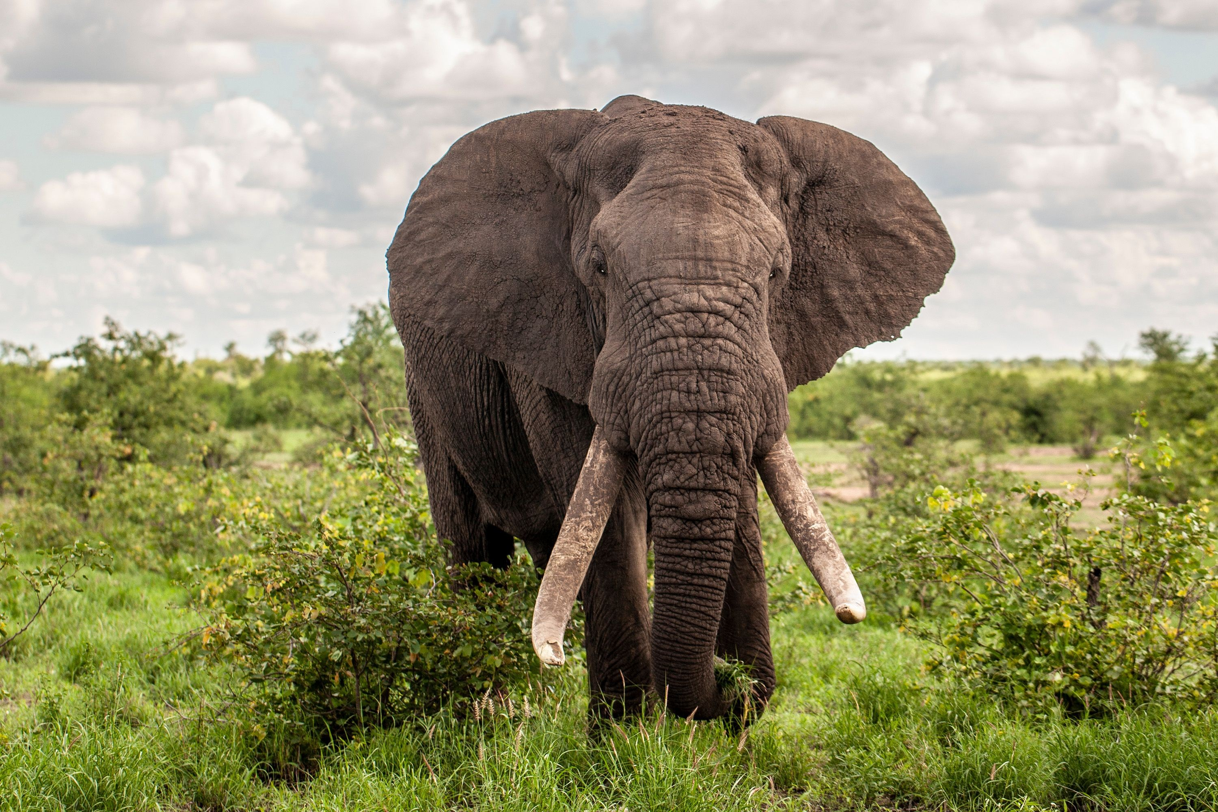
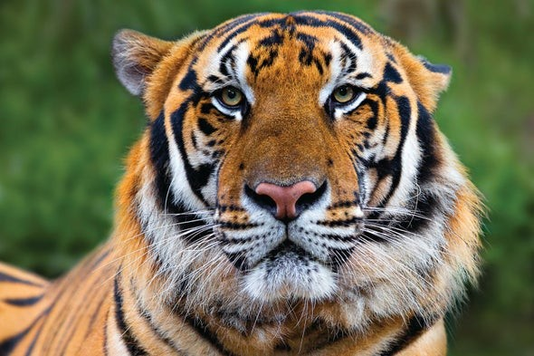
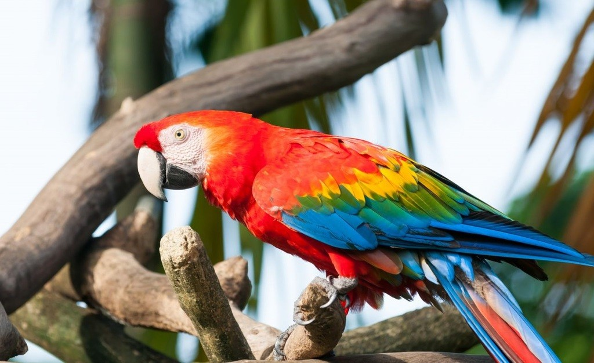
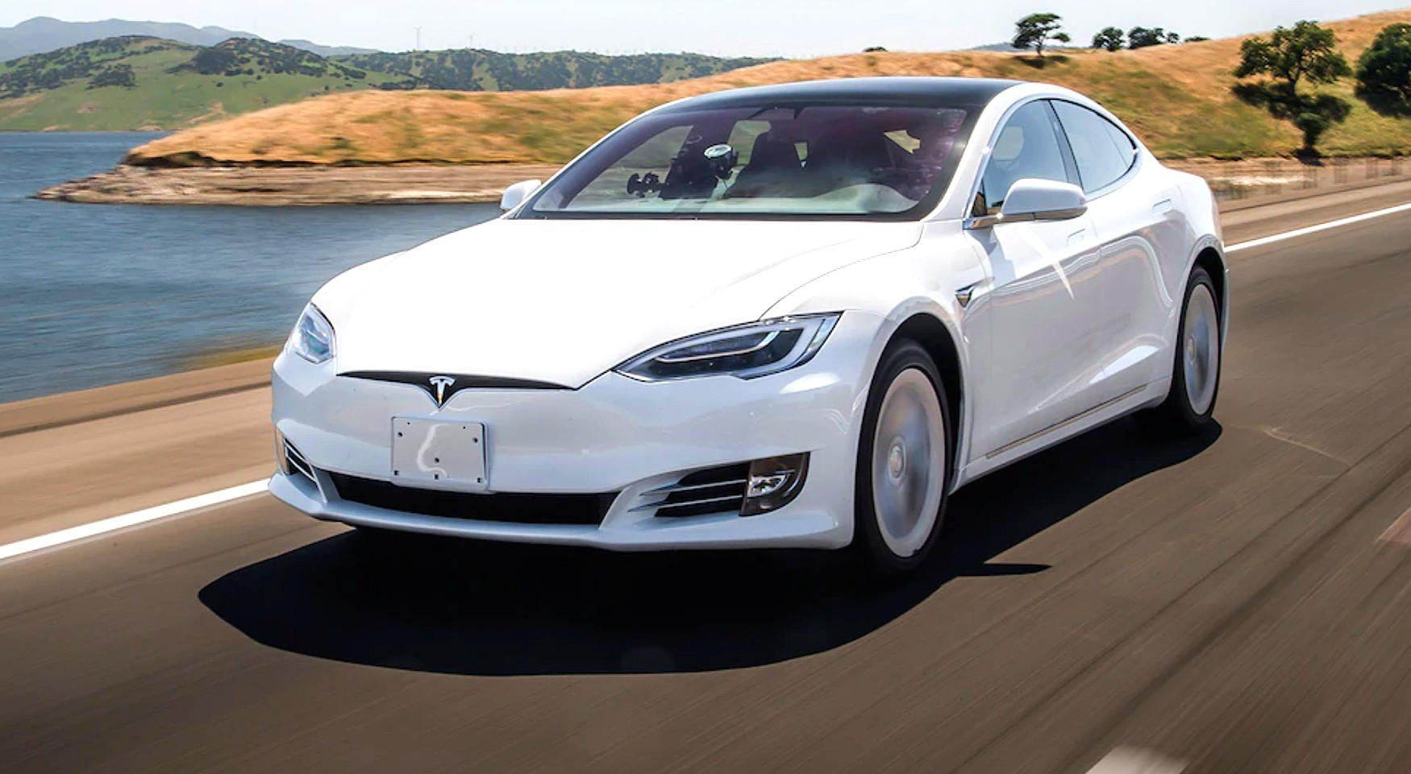
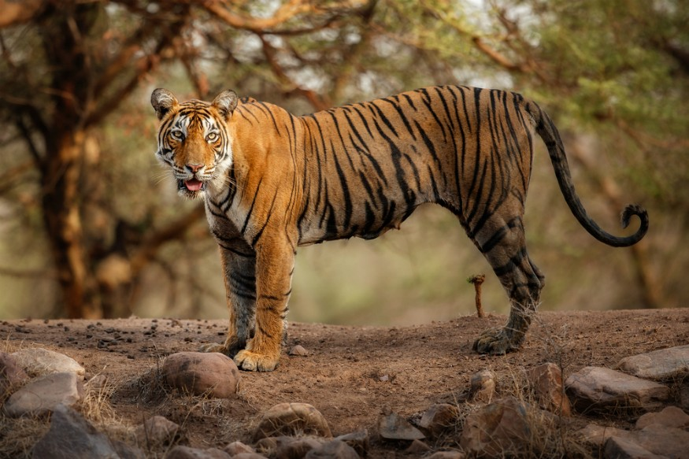
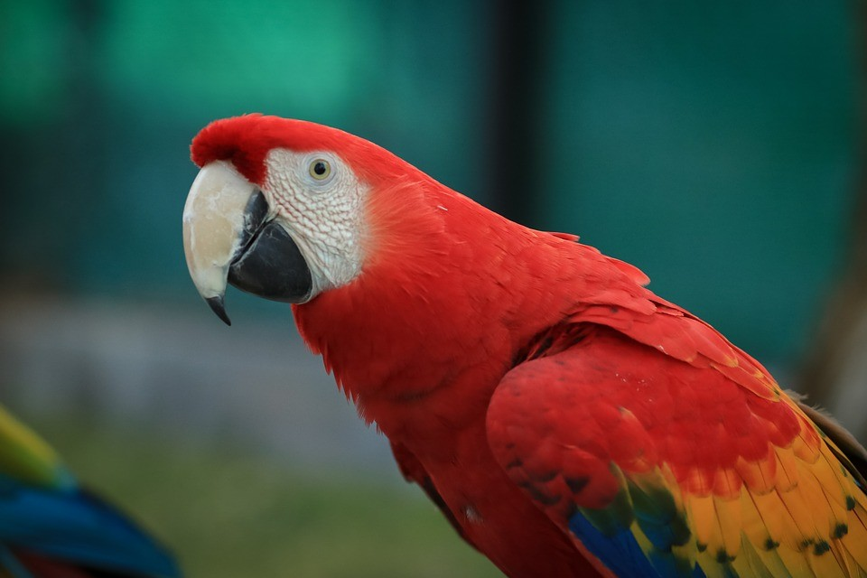
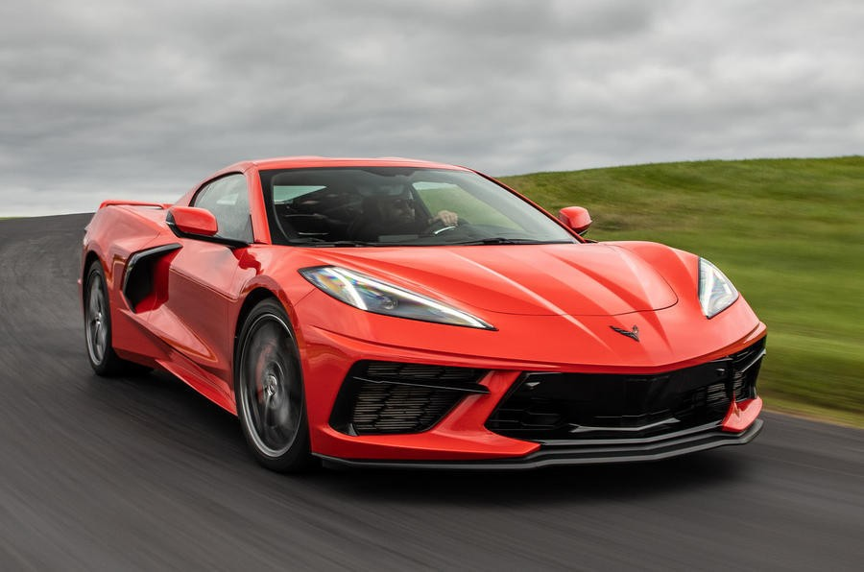
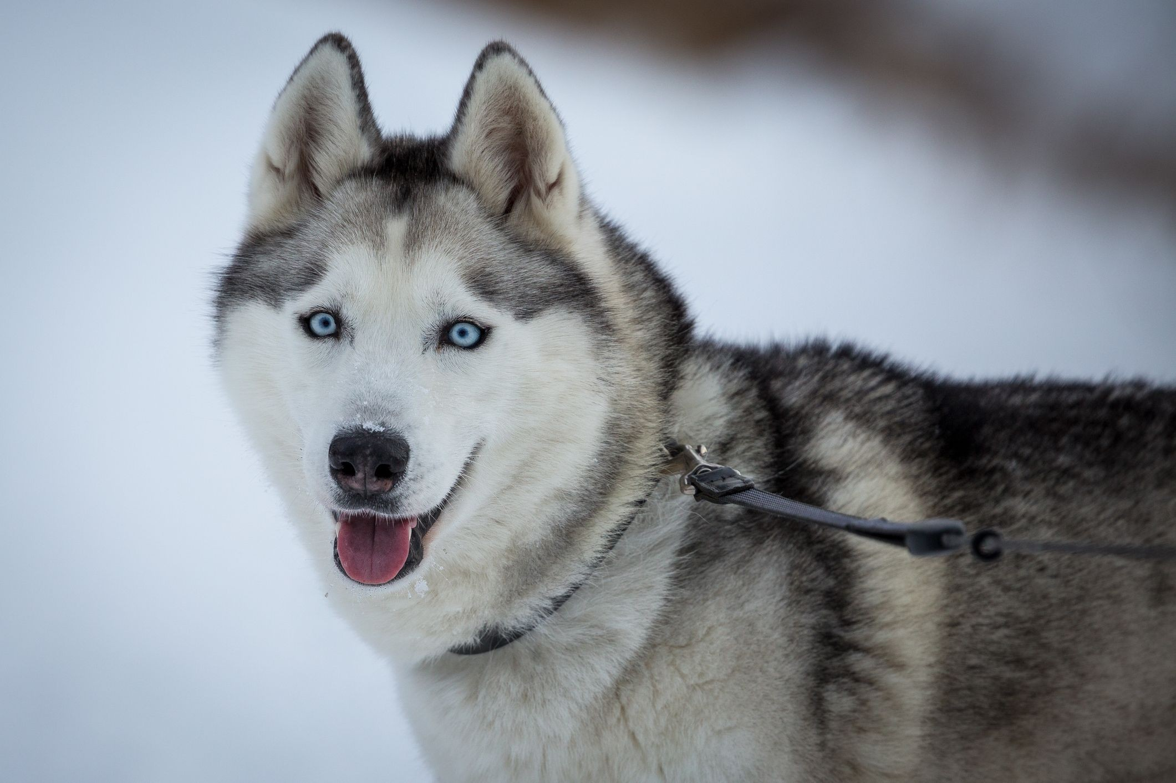
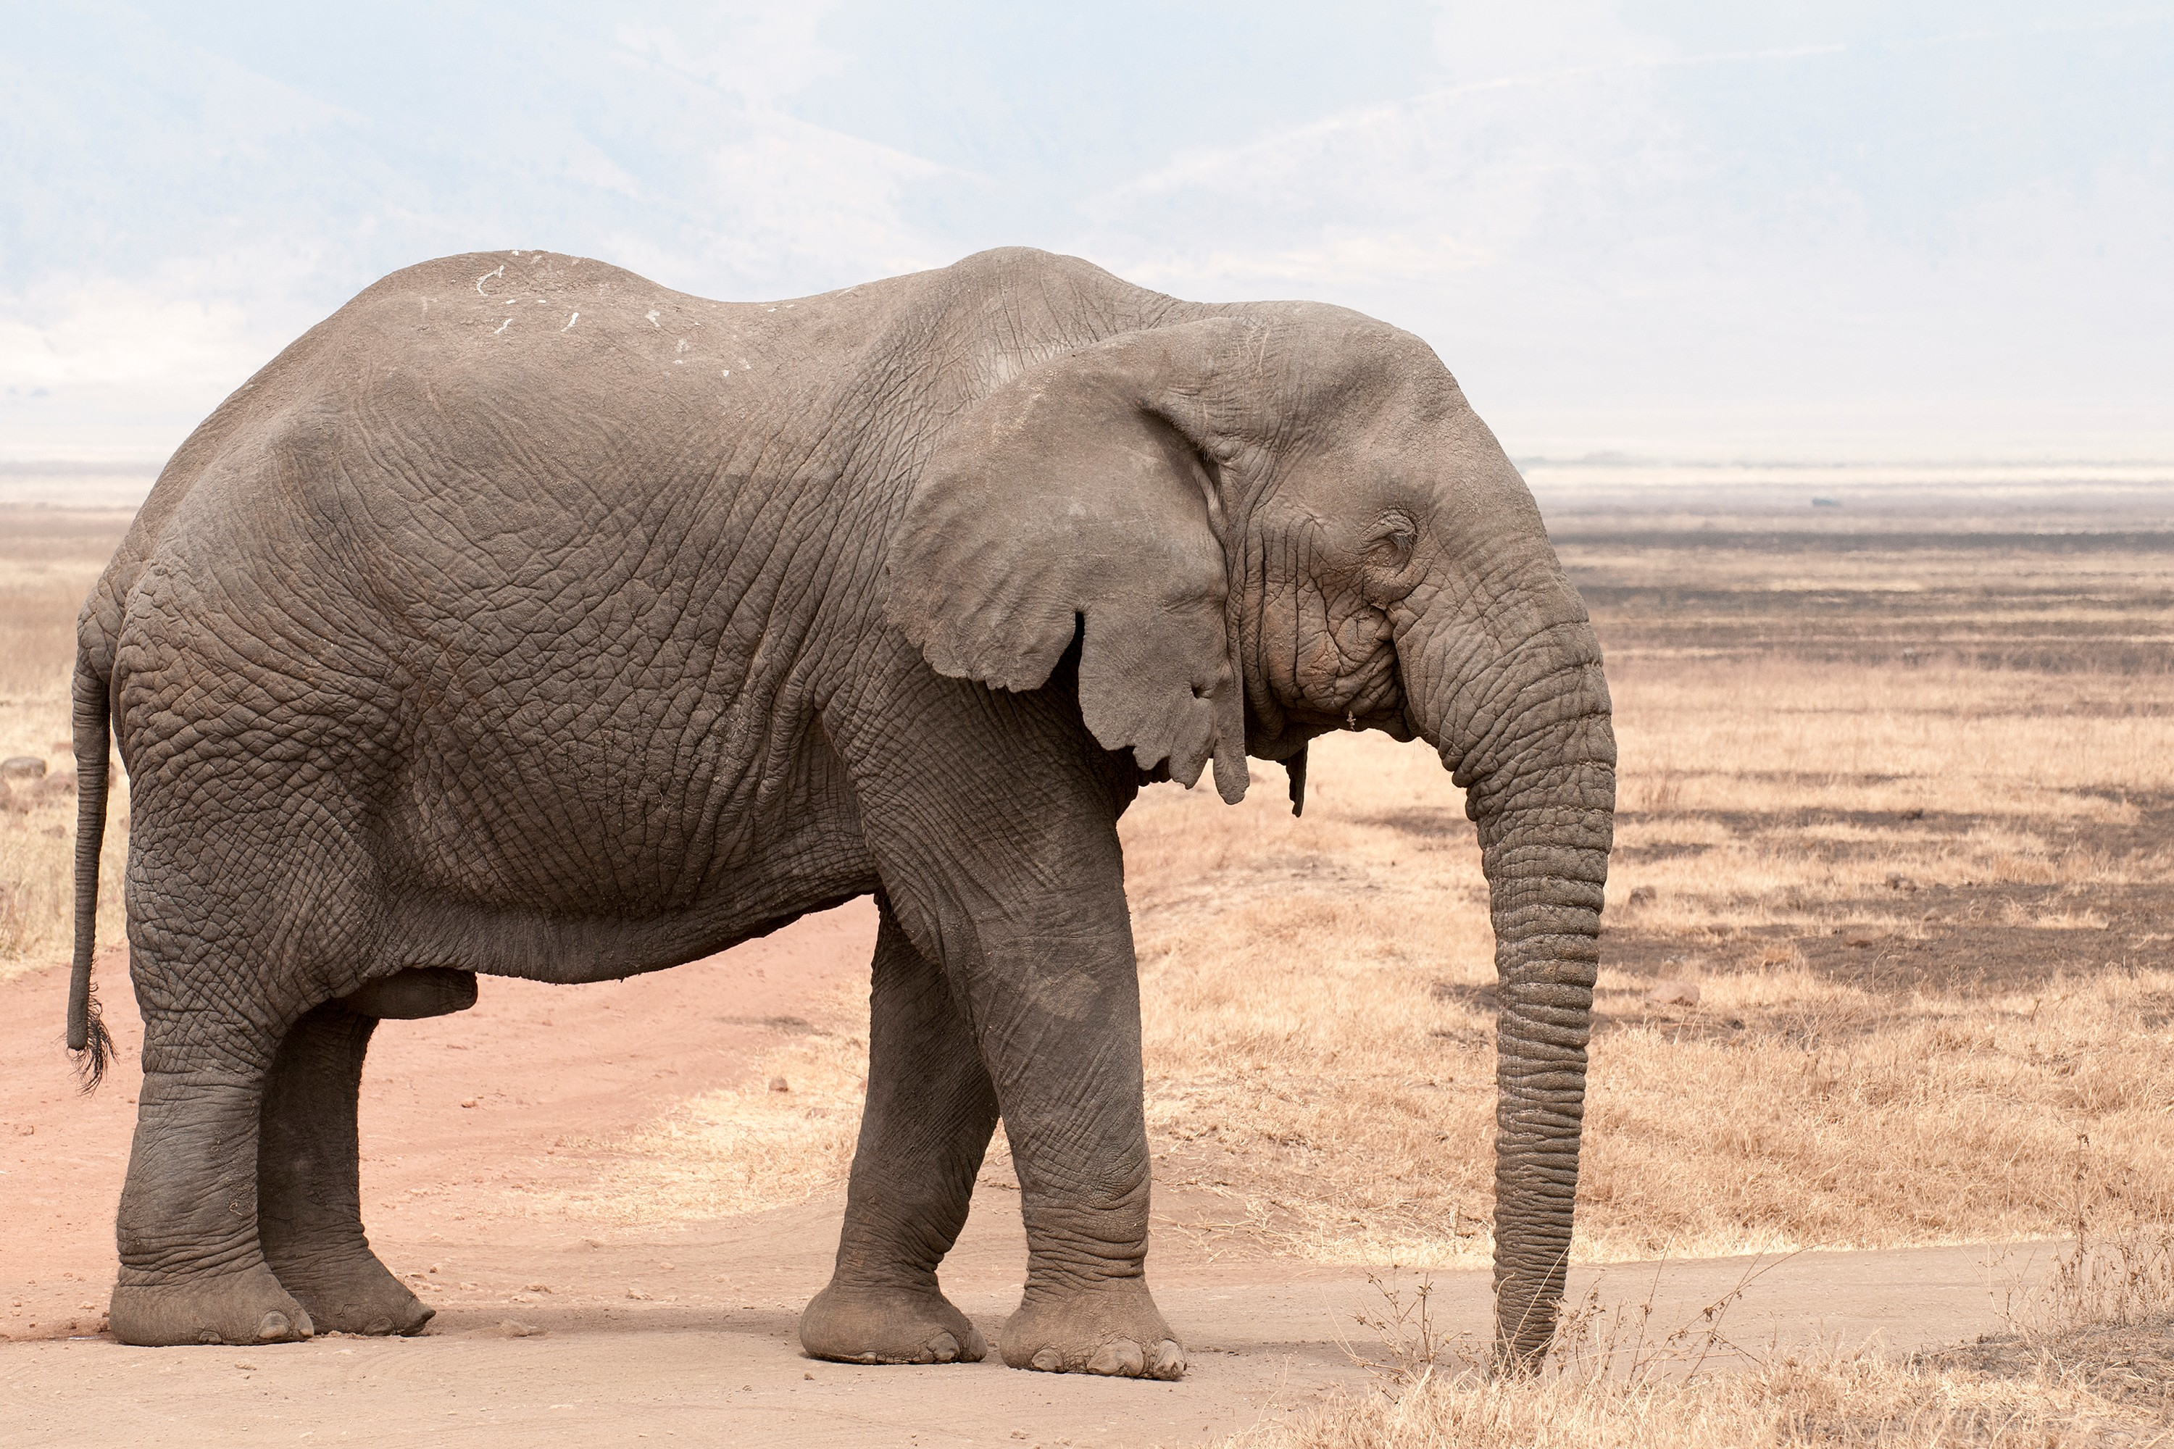
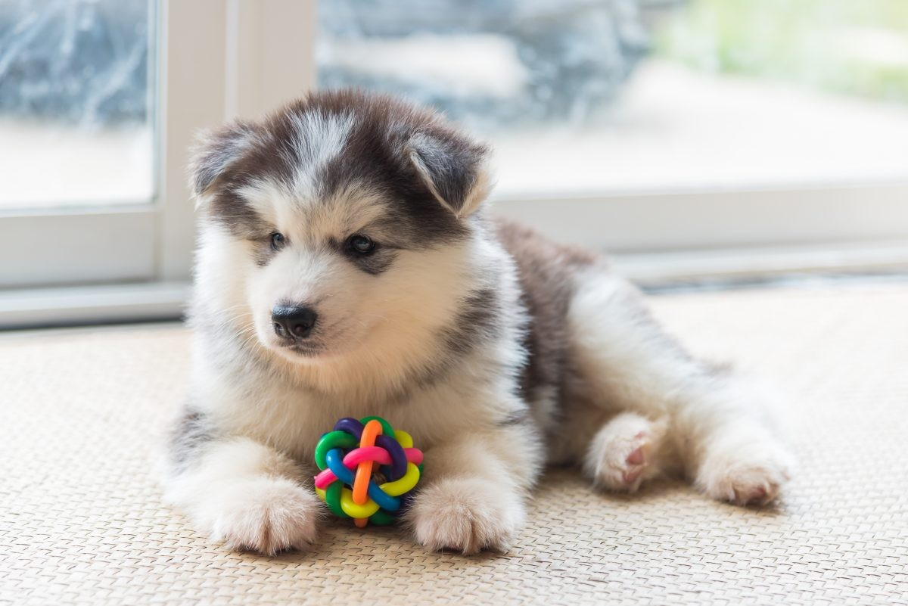
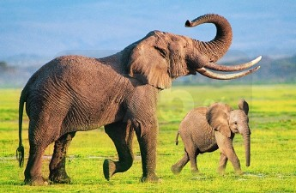
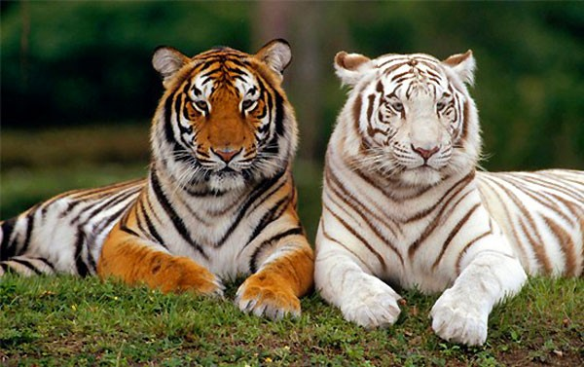
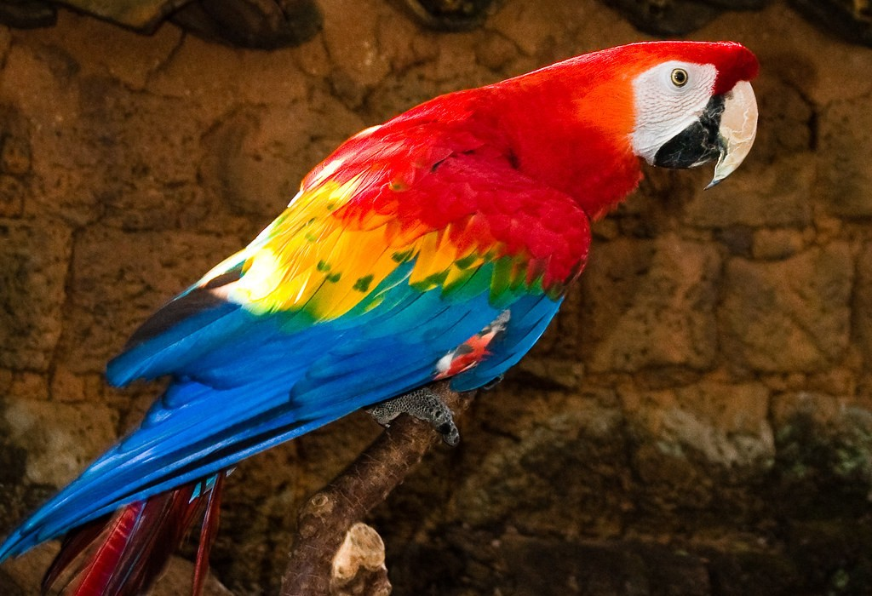
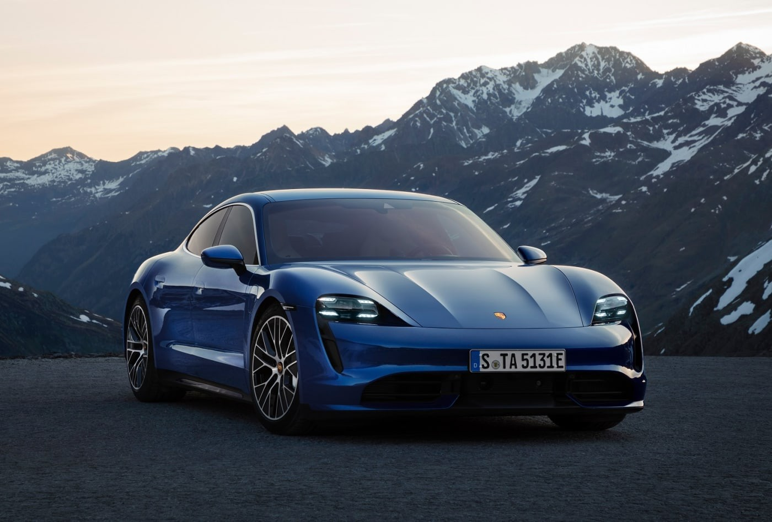
Training Set
Husky
Elephant
Tiger
Macaw
Car
⋮
⋮
⋮
⋮
⋮

Slide 4
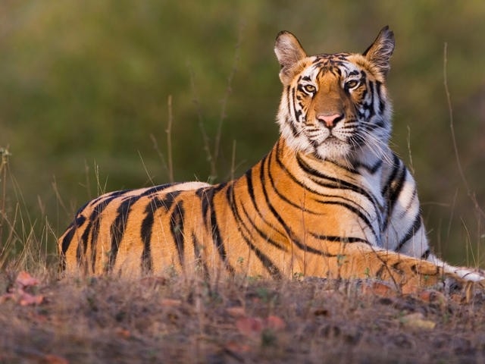
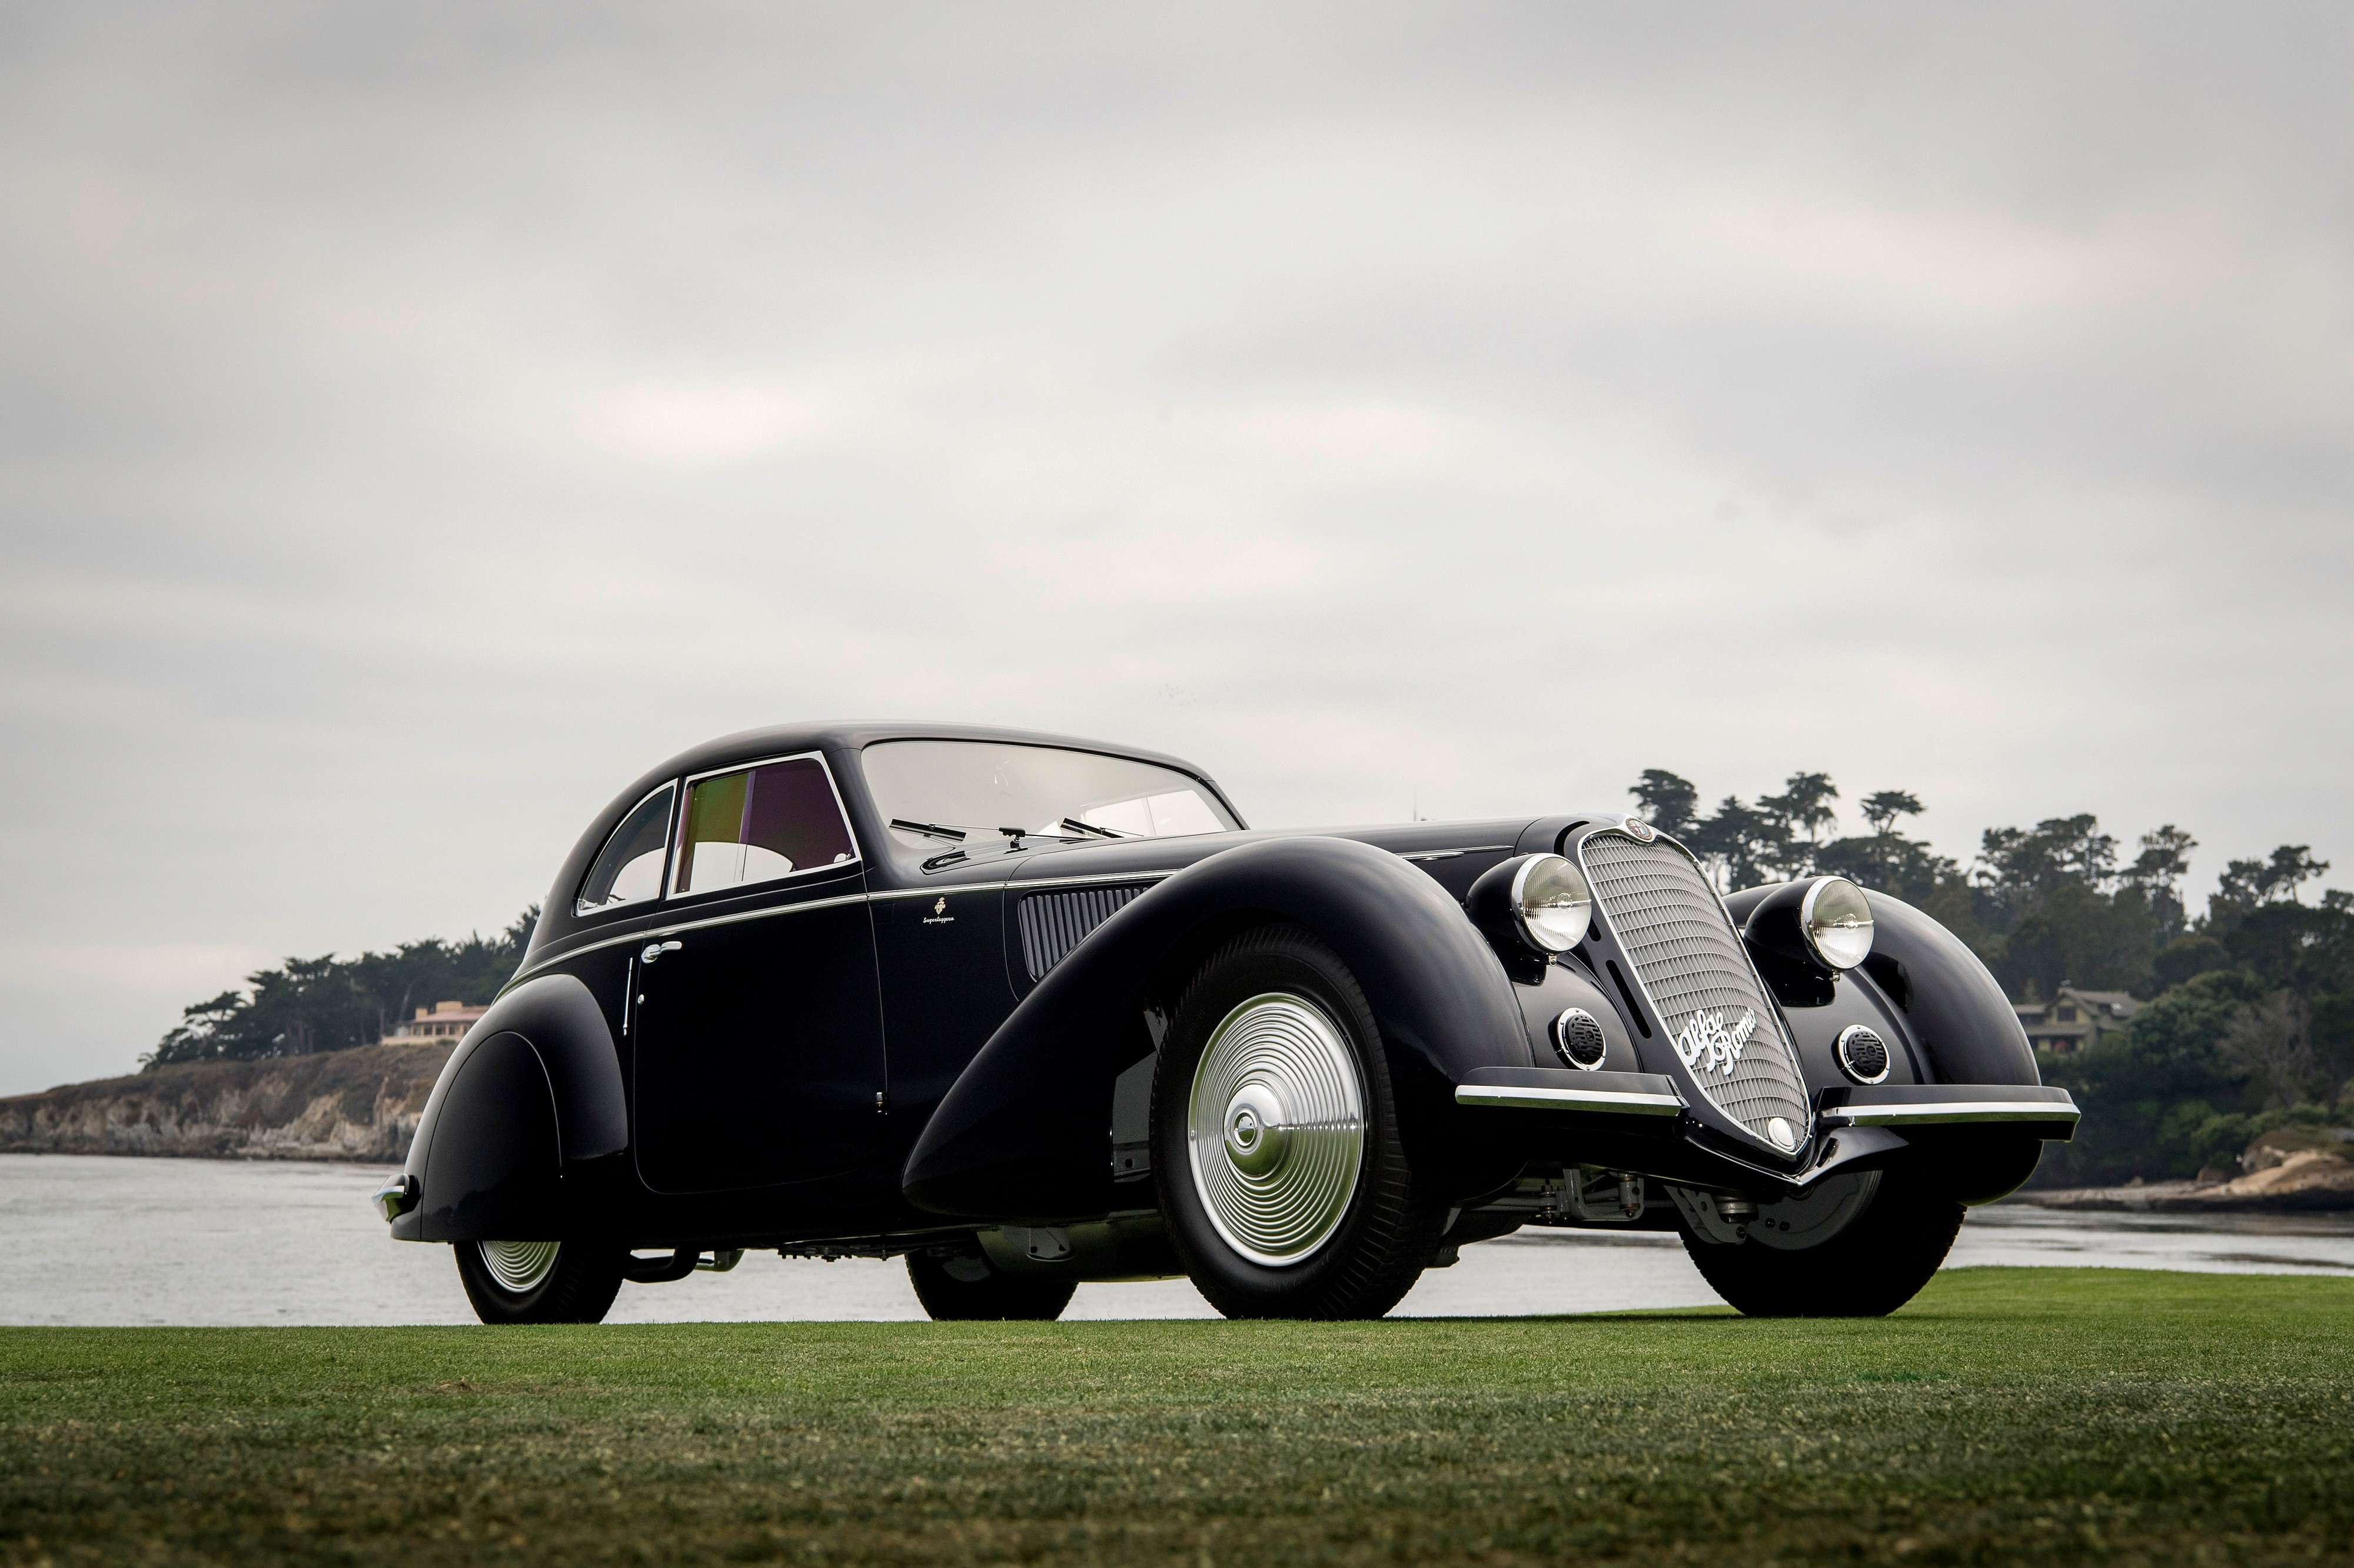
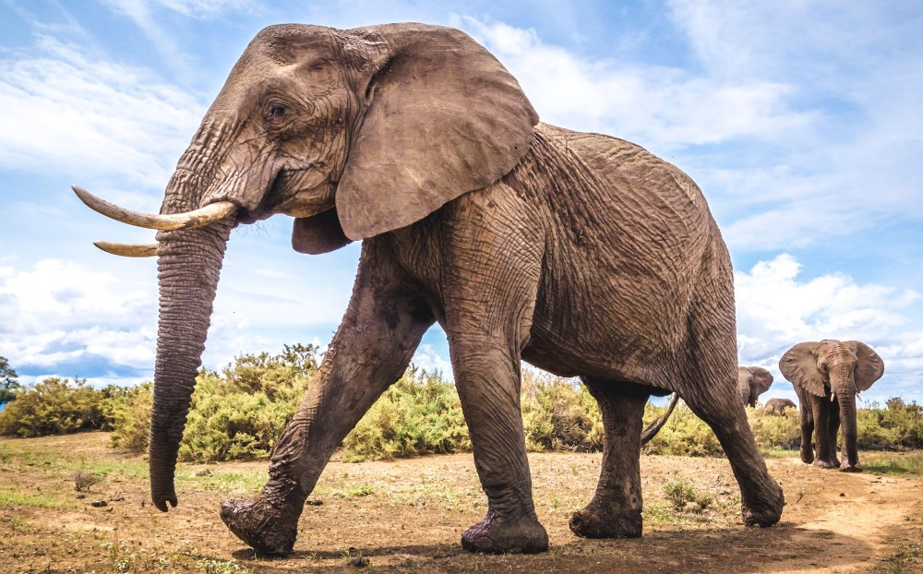
Training Data
Positive Samples
Negative Samples
( , , 1)
( , , 1)
( , , 1)
( , , 0)
( , , 0)
( , , 0)

Slide 5




CNN for Feature Extraction
Conv, Pool
Conv, Pool
Flatten
𝐱
𝐟 𝐱

Slide 6
Training Siamese Network
𝐱$
𝐱₂

Slide 7
Training Siamese Network
𝐟
𝐱$
𝐟
𝐱₂

Slide 8
Training Siamese Network
𝐟
𝐱$
𝐡$ = 𝐟 𝐱$
𝐟
𝐱₂
𝐡₂ = 𝐟 𝐱₂

Slide 9
Training Siamese Network
𝐟
𝐱$
𝐡$
𝐟
𝐳 = 𝐡$ − 𝐡₂
𝐱₂
𝐡₂

Slide 10

Training Siamese Network
𝐟
𝐱$
Dense Layers
𝐡$
𝐟
𝐳
𝐱₂
𝐡₂

Slide 11
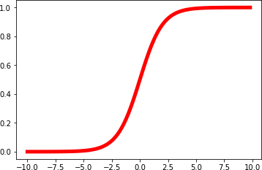
Training Siamese Network
𝐟
𝐱$
Dense Layers
𝐡
Sigmoid
$
sim 𝐱$, 𝐱₂
𝐟
𝐳
𝐱₂
𝐡₂

Slide 12
Training Siamese Network
Target = 1
Loss
𝐟
𝐱$
Dense Layers
𝐡
Sigmoid
$
sim 𝐱$, 𝐱₂
𝐟
𝐳
𝐱₂
𝐡₂

Slide 13
Training Siamese Network
Loss
Target = 1
^{𝐱}$ 𝐡$ Sigmoid
sim 𝐱$, 𝐱₂
𝐳
𝐱₂ 𝐡₂
𝐟
Dense Layers
𝐟

Slide 14
Training Siamese Network
Loss
Target = 1
^{𝐱}$ 𝐡$ Sigmoid
sim 𝐱$, 𝐱₂
𝐱₂ 𝐡₂
𝐟
Dense Layers
𝐟
𝐳

Slide 15
Training Siamese Network
Loss
Target = 1
^{𝐱}$ 𝐡$ Sigmoid
sim 𝐱$, 𝐱₂
𝐱₂ 𝐡₂
𝐟
Dense Layers
𝐟
𝐳

Slide 16
Training Siamese Network
Target = 0
Loss
𝐟
𝐱$
Dense Layers
𝐡
Sigmoid
$
sim 𝐱$, 𝐱₂
𝐟
𝐳
𝐱₂
𝐡₂

Slide 17
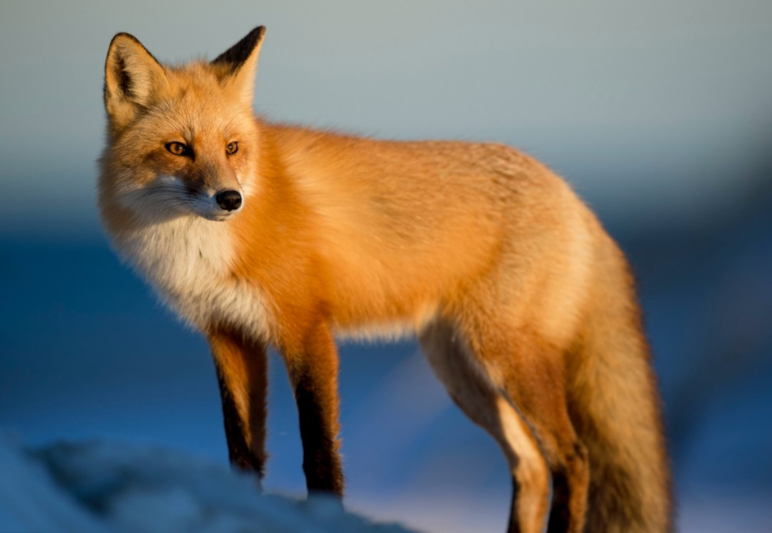
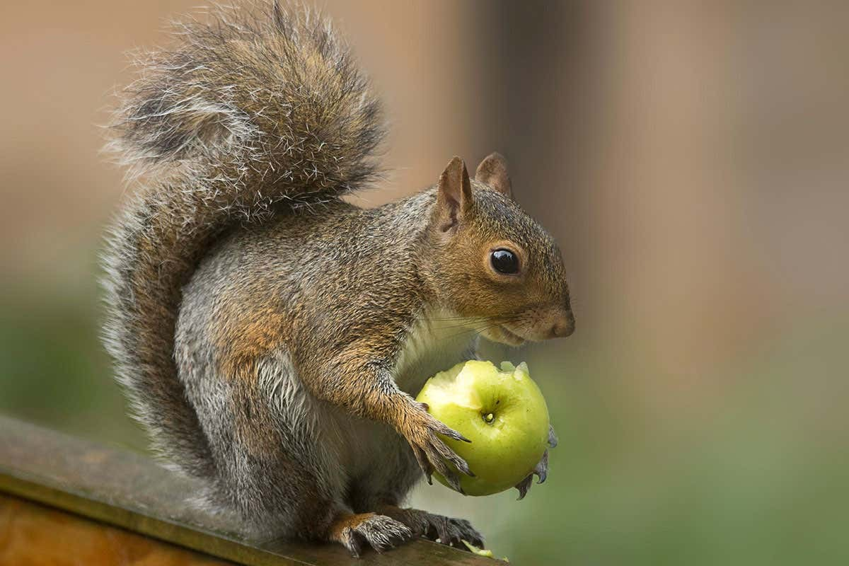
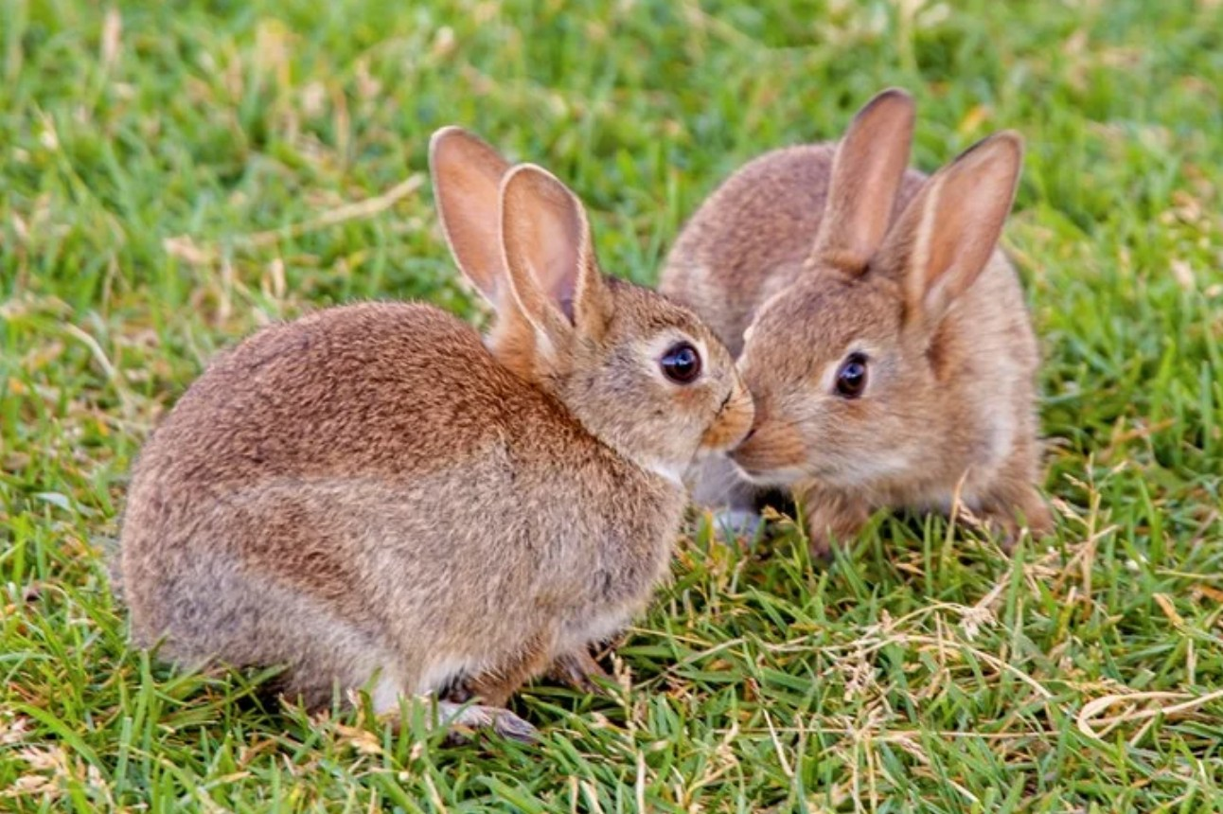
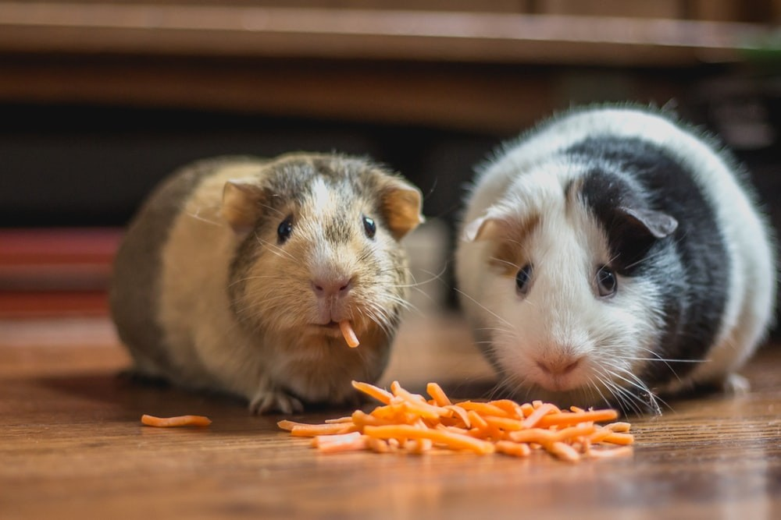
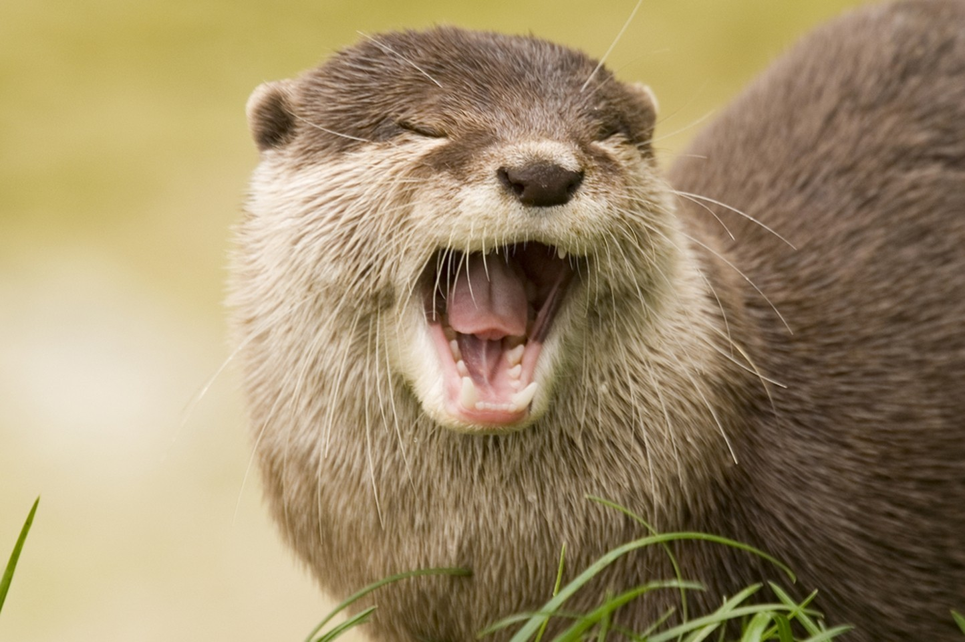
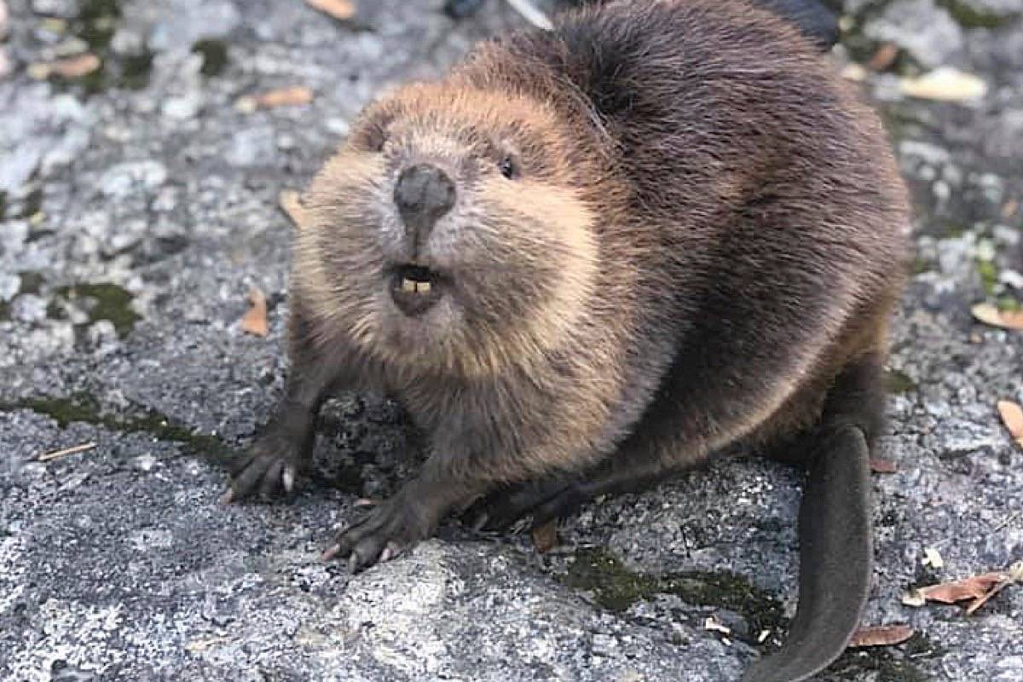
One-Shot Prediction
6-way 1-shot prediction: support set has 6 test classes; each class has 1 sample.
The training data (for the Siamese network) does not contain the 6 classes.
Support Set:
Rabbit Hamster
Fox
Squirrel
Otter
Beaver

Slide 18
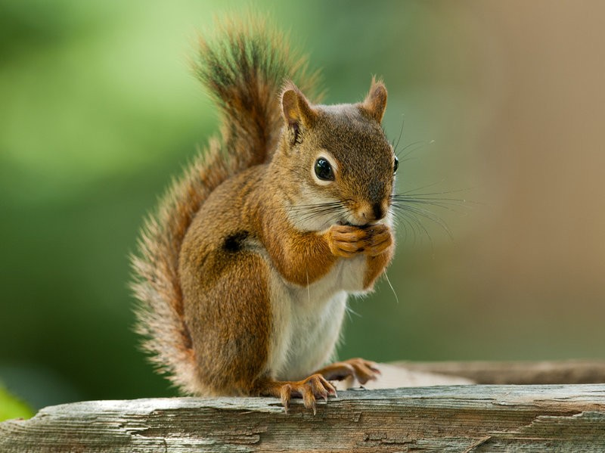
One-Shot Prediction
Query:
Support Set:
Rabbit Hamster
Fox
Squirrel
Otter
Beaver

Slide 19
One-Shot Prediction
Query:
sim = 0.2
Fox
Squirrel
Rabbit
Hamster
Otter
Beaver

Slide 20
One-Shot Prediction
Query:
sim = 0.2
sim = 0.9
Fox
Squirrel
Rabbit
Hamster
Otter
Beaver

Slide 21
One-Shot Prediction
Query:
sim = 0.2
sim = 0.9
sim = 0.7
sim = 0.5
sim = 0.3
sim = 0.4
Fox
Squirrel
Rabbit
Hamster
Otter
Beaver

Slide 22
One-Shot Prediction
Query:
sim = 0.9
Squirrel
sim = 0.2
sim = 0.7
sim = 0.5
sim = 0.3
sim = 0.4
Fox
Rabbit
Hamster
Otter
Beaver

Slide 23
Triplet Loss
Reference:
Schroff, Kalenichenko, & Philbin. Facenet: A unified embedding for face recognition and clustering. In
CVPR, 2015.

Slide 24
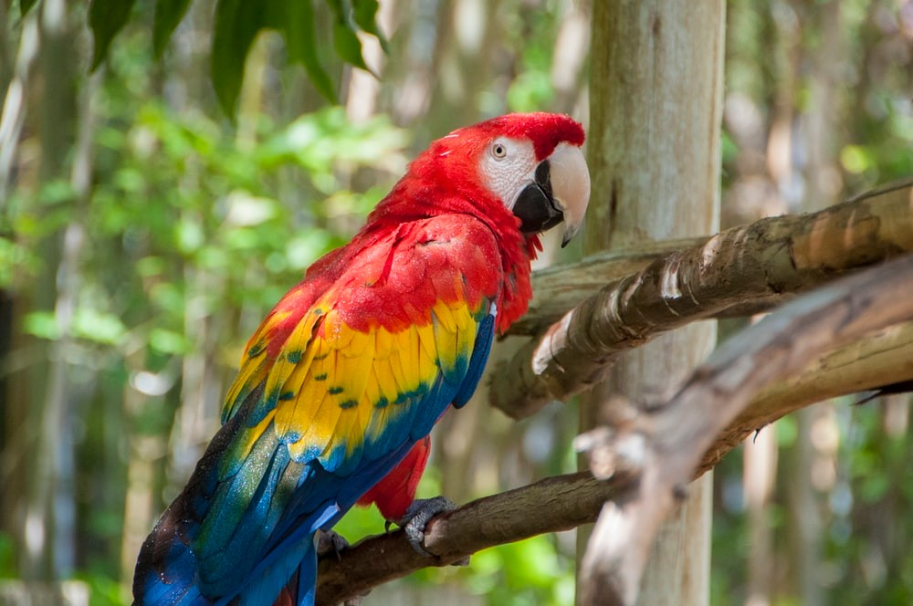
Data for Training Siamese Network
Training Set
Elephant Tiger Macaw
Car

Slide 25
Data for Training Siamese Network
Training Set
Elephant Tiger Macaw
Car
anchor

Slide 26
Data for Training Siamese Network
Training Set
Elephant Tiger Macaw
Car
anchor

Slide 27
Data for Training Siamese Network
Training Set
Elephant Tiger Macaw
Positive
Car

Slide 28
Data for Training Siamese Network
Training Set
Elephant Tiger Macaw
Positive
Car

Slide 29
Data for Training Siamese Network
Training Set
Elephant Tiger Macaw
Car
Negative

Slide 30
Data for Training Siamese Network
Training Set
Elephant Tiger Macaw
Car
Negative

Slide 31
Triplet Loss
_{𝐱}7
(positive)
_{𝐱}6
(anchor)
_{𝐱}–
(negative)

Slide 32

Triplet Loss
_{𝐱}7
(positive)
𝐟
_{𝐱}6
(anchor)
𝐟
_{𝐱}–
𝐟
(negative)

Slide 33
Triplet Loss
_{𝐱}7
(positive)
𝐟
𝐟 𝐱⁷
_{𝐱}6
(anchor)
𝐟
𝐟 𝐱⁶
_{𝐱}–
(negative)
𝐟
𝐟 𝐱–

Slide 34
Triplet Loss
_{𝐱}7
(positive)
𝐟
𝐟 𝐱⁷
2
2
𝑑⁷ =
𝐟 𝐱⁷
− 𝐟 𝐱⁶
_{𝐱}6
(anchor)
𝐟
𝐟 𝐱⁶
_{𝐱}–
(negative)
𝐟
𝐟 𝐱–

Slide 35
Triplet Loss
_{𝐱}7
(positive)
𝐟
𝐟 𝐱⁷
2
2
𝑑⁷ =
𝐟 𝐱⁷
− 𝐟 𝐱⁶
_{𝐱}6
(anchor)
𝐟
𝐟 𝐱⁶
2
2
𝑑– =
𝐟 𝐱⁶
− 𝐟 𝐱–
–
𝐟
𝐱
(negative)
𝐟 𝐱–

Slide 36
Triplet Loss
_{𝐱}7
(positive)
Feature Space
_{𝐱}6
(anchor)
_{𝐱}–
(negative)
𝐟 𝐱⁶

Slide 37
Triplet Loss
_{𝐱}7
(positive)
Feature Space
_{𝐱}6
(anchor)
_{𝑑}7
𝐟 𝐱
7
_{𝐱}–
(negative)
𝐟 𝐱⁶

Slide 38
Triplet Loss
_{𝐱}7
(positive)
Feature Space
𝐟 𝐱–
_{𝐱}6
(anchor)
_{𝑑}–
_{𝑑}7
𝐟 𝐱
7
_{𝐱}–
𝐟 𝐱⁶
(negative)

Slide 39
Triplet Loss
_{𝐱}7
(positive)
2
2
2
2
Encourage 𝑑⁷ =
𝐟 𝐱⁷
− 𝐟 𝐱⁶
to be small.
–
6
–
Encourage 𝑑 = 𝐟 𝐱
− 𝐟 𝐱
to be big.
_{𝐱}6
(anchor)
_{𝐱}–
(negative)

Slide 40
Triplet Loss
_{𝐱}7
(positive)
2
2
2
2
Encourage 𝑑⁷ =
𝐟 𝐱⁷
− 𝐟 𝐱⁶
to be small.
Encourage 𝑑– = 𝐟 𝐱⁶ − 𝐟 𝐱–
to be big.
If 𝑑– ≥ 𝑑⁷ + 𝛼, then no loss. (𝛼 > 0 is margin.)
Otherwise, the loss is 𝑑⁷ + 𝛼 − 𝑑–.
𝐱
6
(anchor)
_{𝐱}–
(negative)

Slide 41
Triplet Loss
_{𝐱}7
(positive)
2
2
2
2
Encourage 𝑑⁷ =
𝐟 𝐱⁷
− 𝐟 𝐱⁶
to be small.
Encourage 𝑑– = 𝐟 𝐱⁶ − 𝐟 𝐱–
to be big.
If 𝑑– ≥ 𝑑⁷ + 𝛼, then no loss. (𝛼 > 0 is margin.)
Otherwise, the loss is 𝑑⁷ + 𝛼 − 𝑑–.
𝐱
6
(anchor)
Loss 𝐱⁶, 𝐱⁷, 𝐱– = max 0, 𝑑⁷ + 𝛼 − 𝑑– .
_{𝐱}–
(negative)
• Update the CNN (function 𝐟) to decrease the loss.

Slide 42
One-Shot Prediction
Query:
Support Set:
Rabbit Hamster
Fox
Squirrel
Otter
Beaver

Slide 43
One-Shot Prediction
Query:
dist = 231
Fox
Squirrel
Rabbit
Hamster
Otter
Beaver

Slide 44
One-Shot Prediction
Query:
dist = 231
dist = 19
Fox
Squirrel
Rabbit
Hamster
Otter
Beaver

Slide 45
One-Shot Prediction
Query:
dist = 231
dist = 19
dist = 138
dist = 76
dist = 122
dist = 94
Fox
Squirrel
Rabbit
Hamster
Otter
Beaver

Slide 46
One-Shot Prediction
Query:
dist = 19
Squirrel
dist = 231
dist = 138
dist = 76
dist = 122
dist = 94
Fox
Rabbit
Hamster
Otter
Beaver

Slide 47
Summary

Slide 48
Basic Idea of Few-Shot Learning
Train a Siamese network on large-scale training set.
Given a support set of 𝑘-way 𝑛-shot.
𝑘-way means 𝑘 classes.
𝑛-shot means every class has 𝑛 samples.
The training set does not contain the 𝑘 classes.
Given a query, predict its class.
Use the Siamese network to compute similarity or distance.

Slide 49
Siamese Network for Pairwise Similarity
Target = 1
Loss
𝐟
𝐱$
Dense Layers
𝐡
Sigmoid
$
sim 𝐱$, 𝐱₂
𝐟
𝐳
𝐱₂
𝐡₂

Slide 50
Siamese Network with Triplet Loss
_{𝐱}7
(positive)
𝐟
𝐟 𝐱⁷
2
2
𝑑⁷ =
𝐟 𝐱⁷
− 𝐟 𝐱⁶
_{𝐱}6
(anchor)
𝐟
𝐟 𝐱⁶
2
2
𝑑– =
𝐟 𝐱⁶
− 𝐟 𝐱–
–
𝐟
𝐱
𝐟 𝐱–
(negative)

Slide 51
Thank you!

